Slide 1

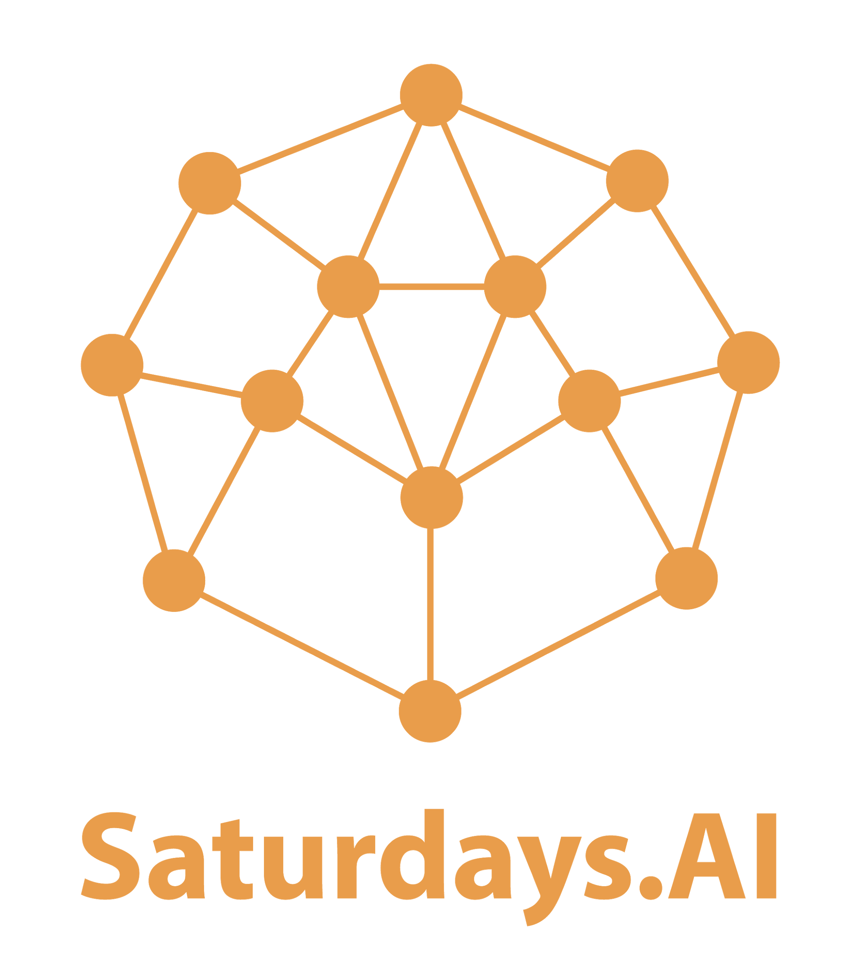
#4 Unsupervised Learning
by Saturdays.AI
Saturdays.AI Madrid
Machine Learning

Slide 2

Week 4
Schedule
State of the course
Session 4 Review
Challenge
Notebook + resources

Slide 3
Sesión 4
Agenda
01:30 - Lesson #4 + Work!
03:30 - Coffee Break ☕️
03: 45 - Keep Working! 🚀
05:00 - Talk: 🗣

Slide 4
State of the course
#1 Exploratory Data Analysis & Classification ✅
#2 Regression & Model Validation ✅
#3 Random Forest Deep Dive ✅
#4 Unsupervised Learning 🔴 Today!
#5 Neural Networks, Gradient Descent 🔜
#6 NLP 🔜

Slide 5
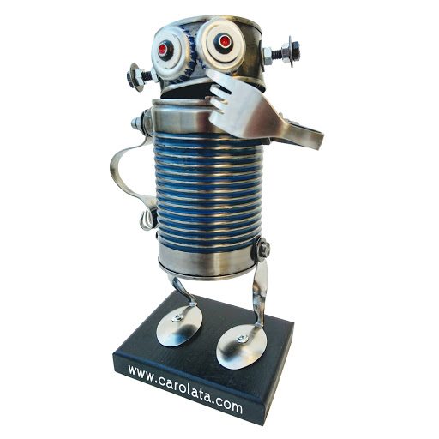
¿Doubts?

Slide 6
Unsupervised Learning
Dimensionality Reduction
Clustering
PCA
K-means

Slide 7
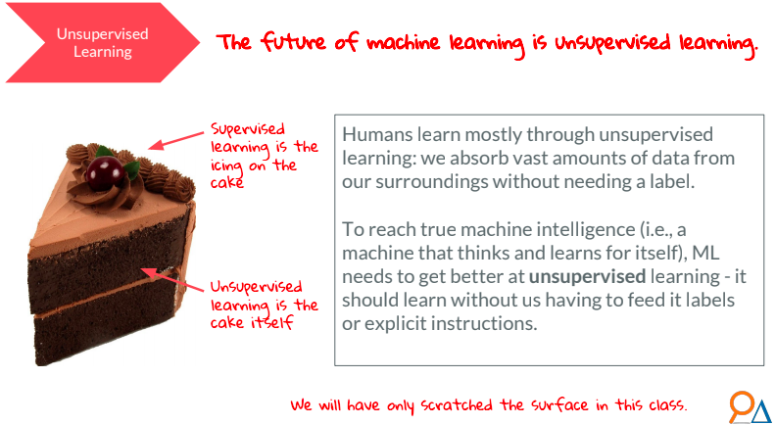
Future of ML

Slide 8
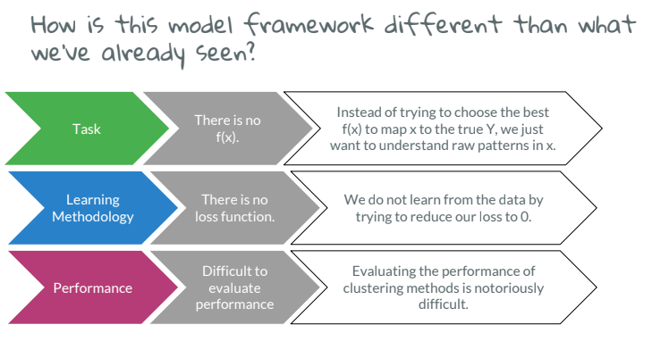
Different Framework

Slide 9
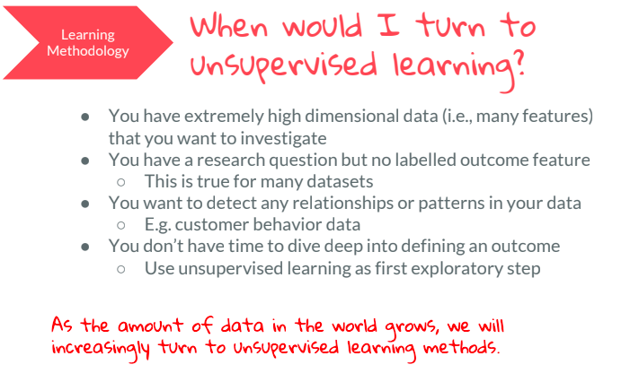
When we use Unsupervised Learning?

Slide 10
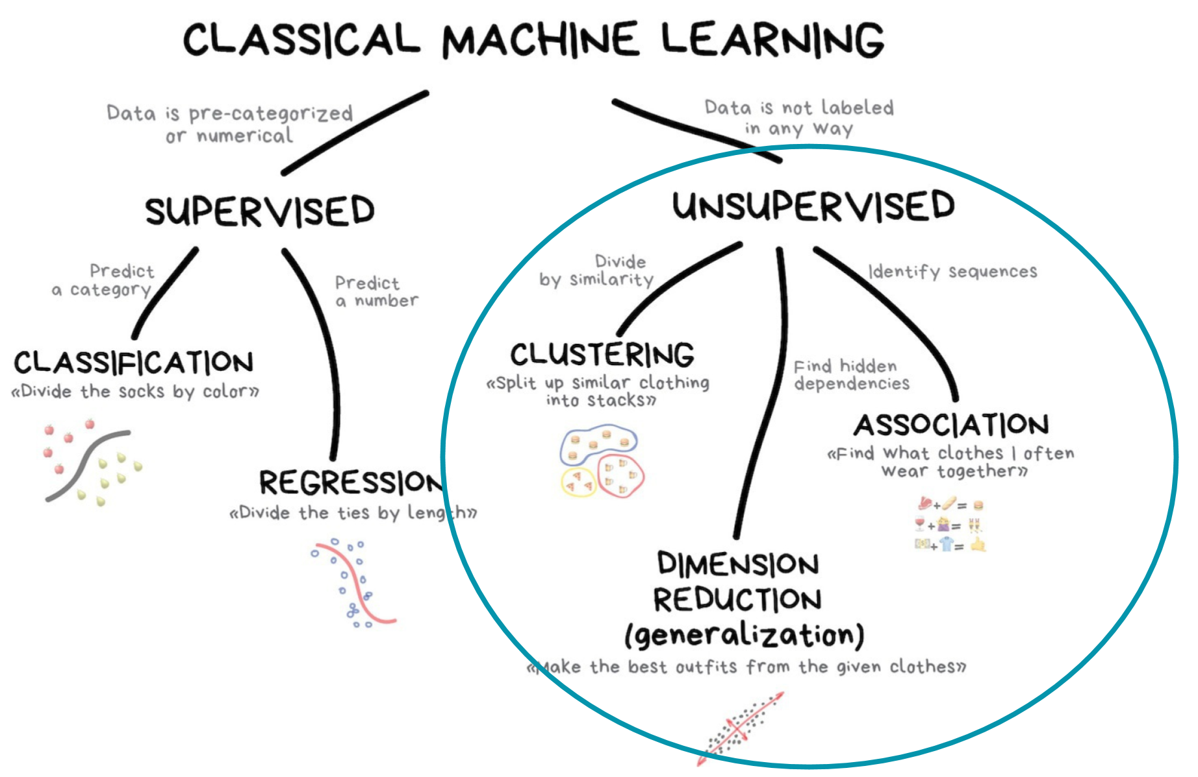
Where we are?
Notes:
Jan

Slide 11
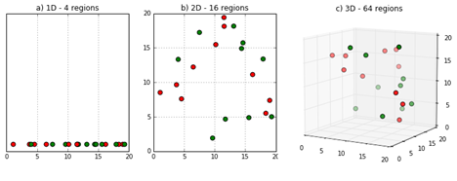
Why dimensionality reduction?
When data has a high dimension (many features), it is extremely complex to process due to inconsistencies in the features, which increase the computational time processing and requires more evoluted EDA (Exploratory Data Analysis).
???
1D
2D
3D
xD
Notes:
Curse of dimensionality: As dimensionality grows, we have fewer observations per region.

Slide 12
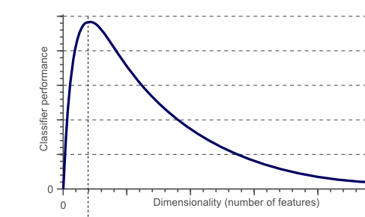
Dimensionality Reduction, Overview
Goal: reduce the number of features (dimensionality) by maximizing the explained variance, to obtaining a set of principal features.
How does it work?: Transforming the data in the high-dimensional space to a space in fewer dimensions.
Advantages:
Removes inconsistencies in the features
Highlight relevant features, not all features are relevant to our problem
Avoids overfitting due to strong correlations
Reduces computational time and space complexity
Disadvantages
More difficult to explain the meaning
We fundamentally “miss” some dat
Notes:
Goal: reducing the number of features (dimensionality) by maximizing the explained variance

Slide 13
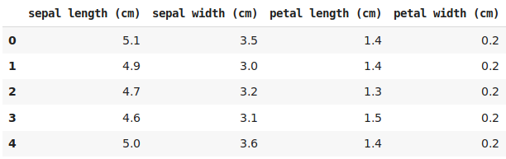
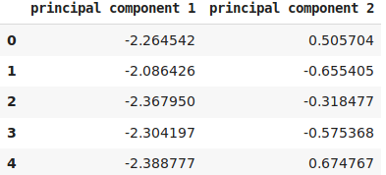

What is PCA?
Principal component analysis (PCA) is a dimensionality reduction technique that enables to identify correlations and patterns in a dataset so it can be transformed into a dataset of significant lower dimensions and keeping the most relevant information.

Slide 14
What is PCA (math definition)?
Principal component analysis (PCA) is statistical procedure that uses an orthogonal transformation to convert a set of observations of possibly correlated variables into a set of values of linearly uncorrelated variables called principal components.
Definition source: https://en.wikipedia.org/wiki/Principal_component_analysis

Slide 15
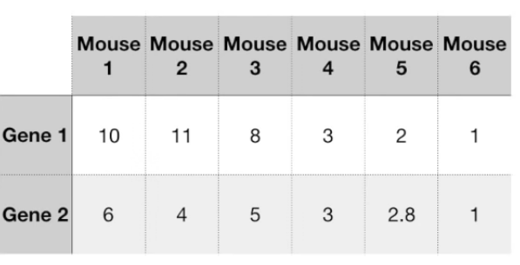
PCA step by step
Standardize the data
Build the covariance matrix
Calculate the Eigenvectors and Eigenvalues
Compute Principal Components
Reduce the data dimensions
Definition source: https://en.wikipedia.org/wiki/Principal_component_analysis
Images source: StatQuest: PCA step by Step

Slide 16
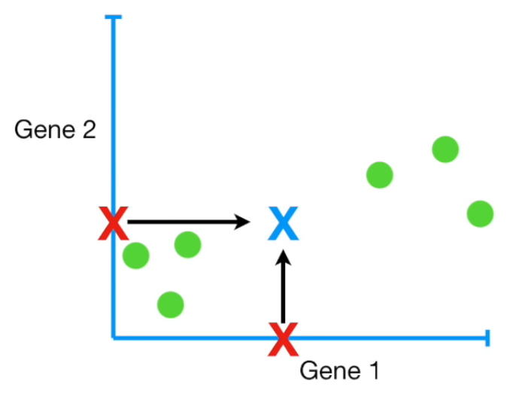
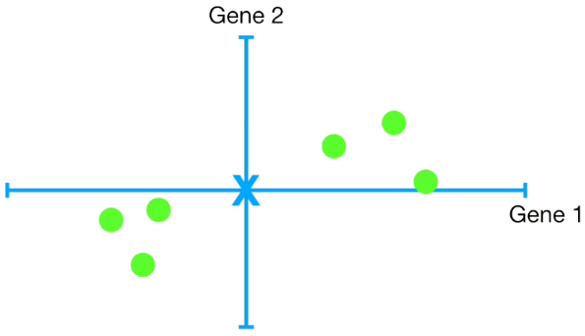
PCA step by step
Standardize the data
Images source: StatQuest: PCA step by Step

Slide 17
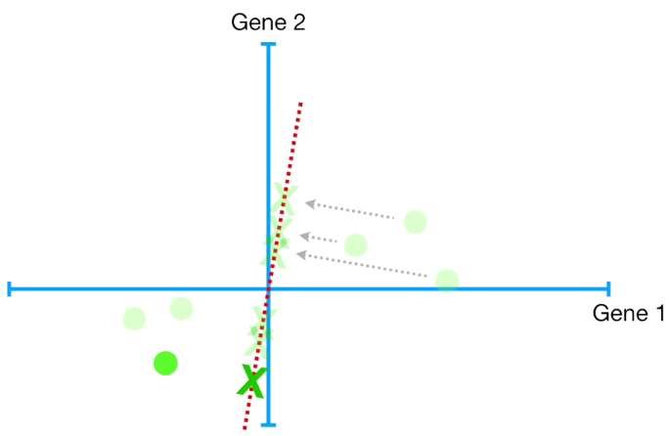
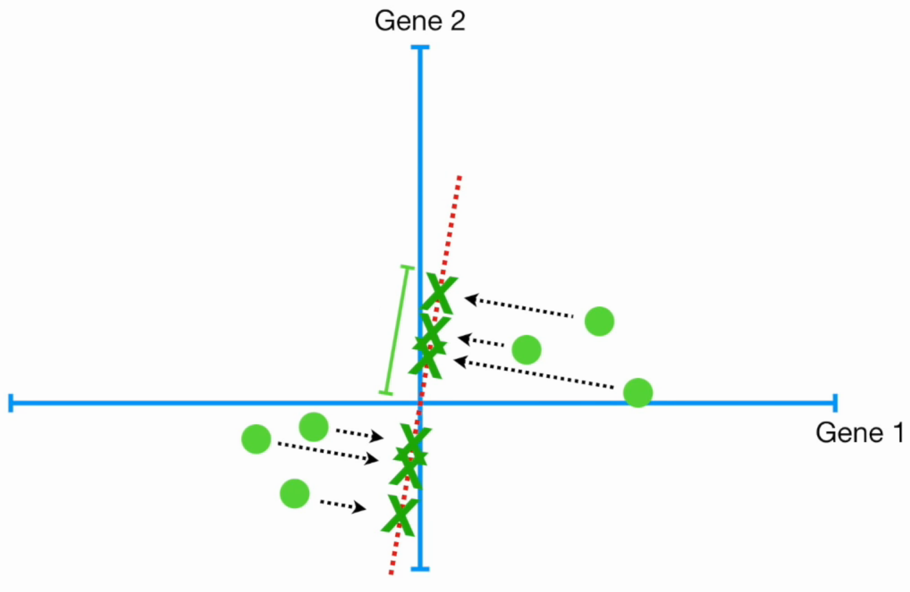
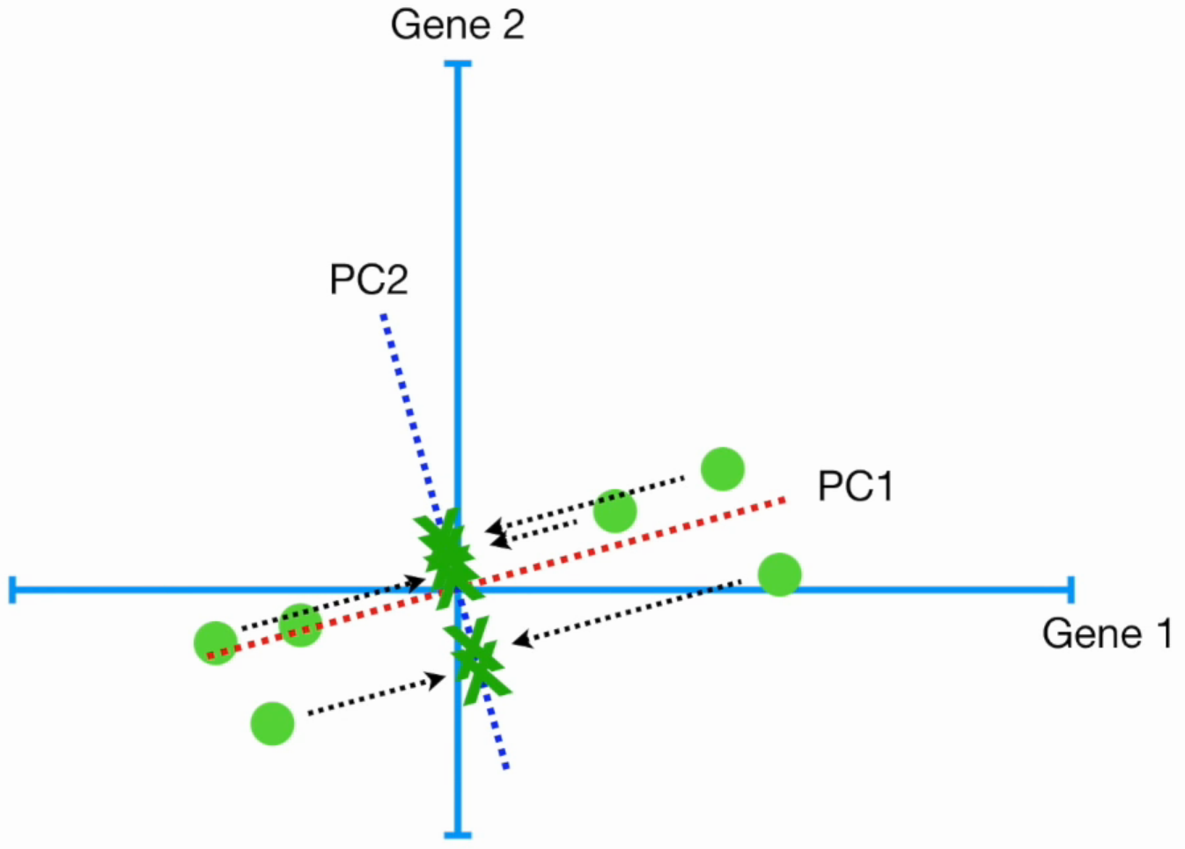
PCA step by step
Build the covariance matrix
Calculate the Eigenvectors and Eigenvalues
Orthogonal transformation feature 1
Orthogonal transformation feature 2
Images source: StatQuest: PCA step by Step

Slide 18
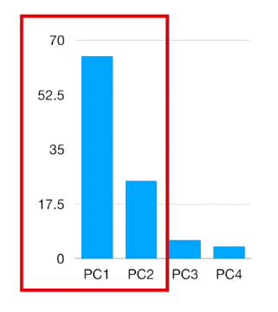
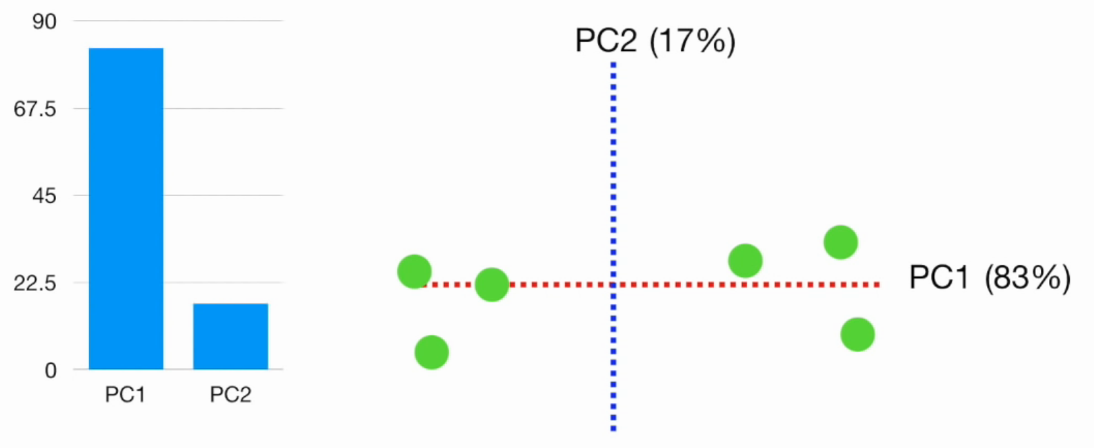
PCA step by step
Compute Principal Components
Reduce the data dimensions
Compute Principal Components
Selected PC
Percentages of variation (%)s
Images source: StatQuest: PCA step by Step

Slide 19
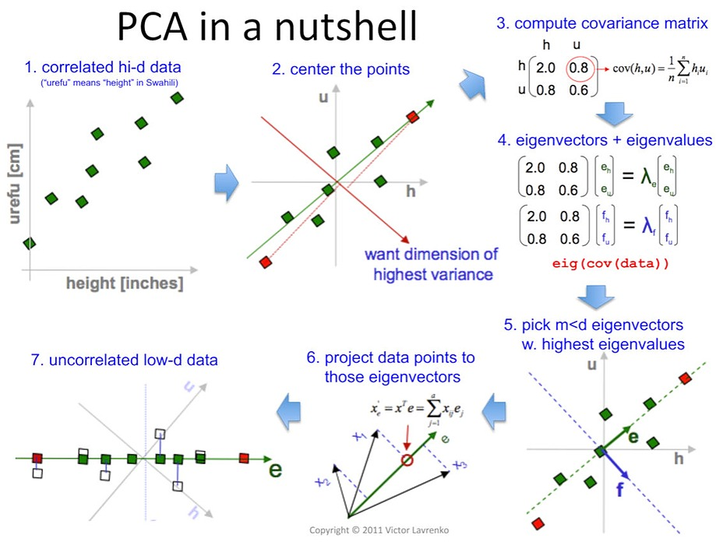
PCA summary
lengh [cm]
height [cm]
Source: Dimensionality Reduction Using PCA

Slide 20
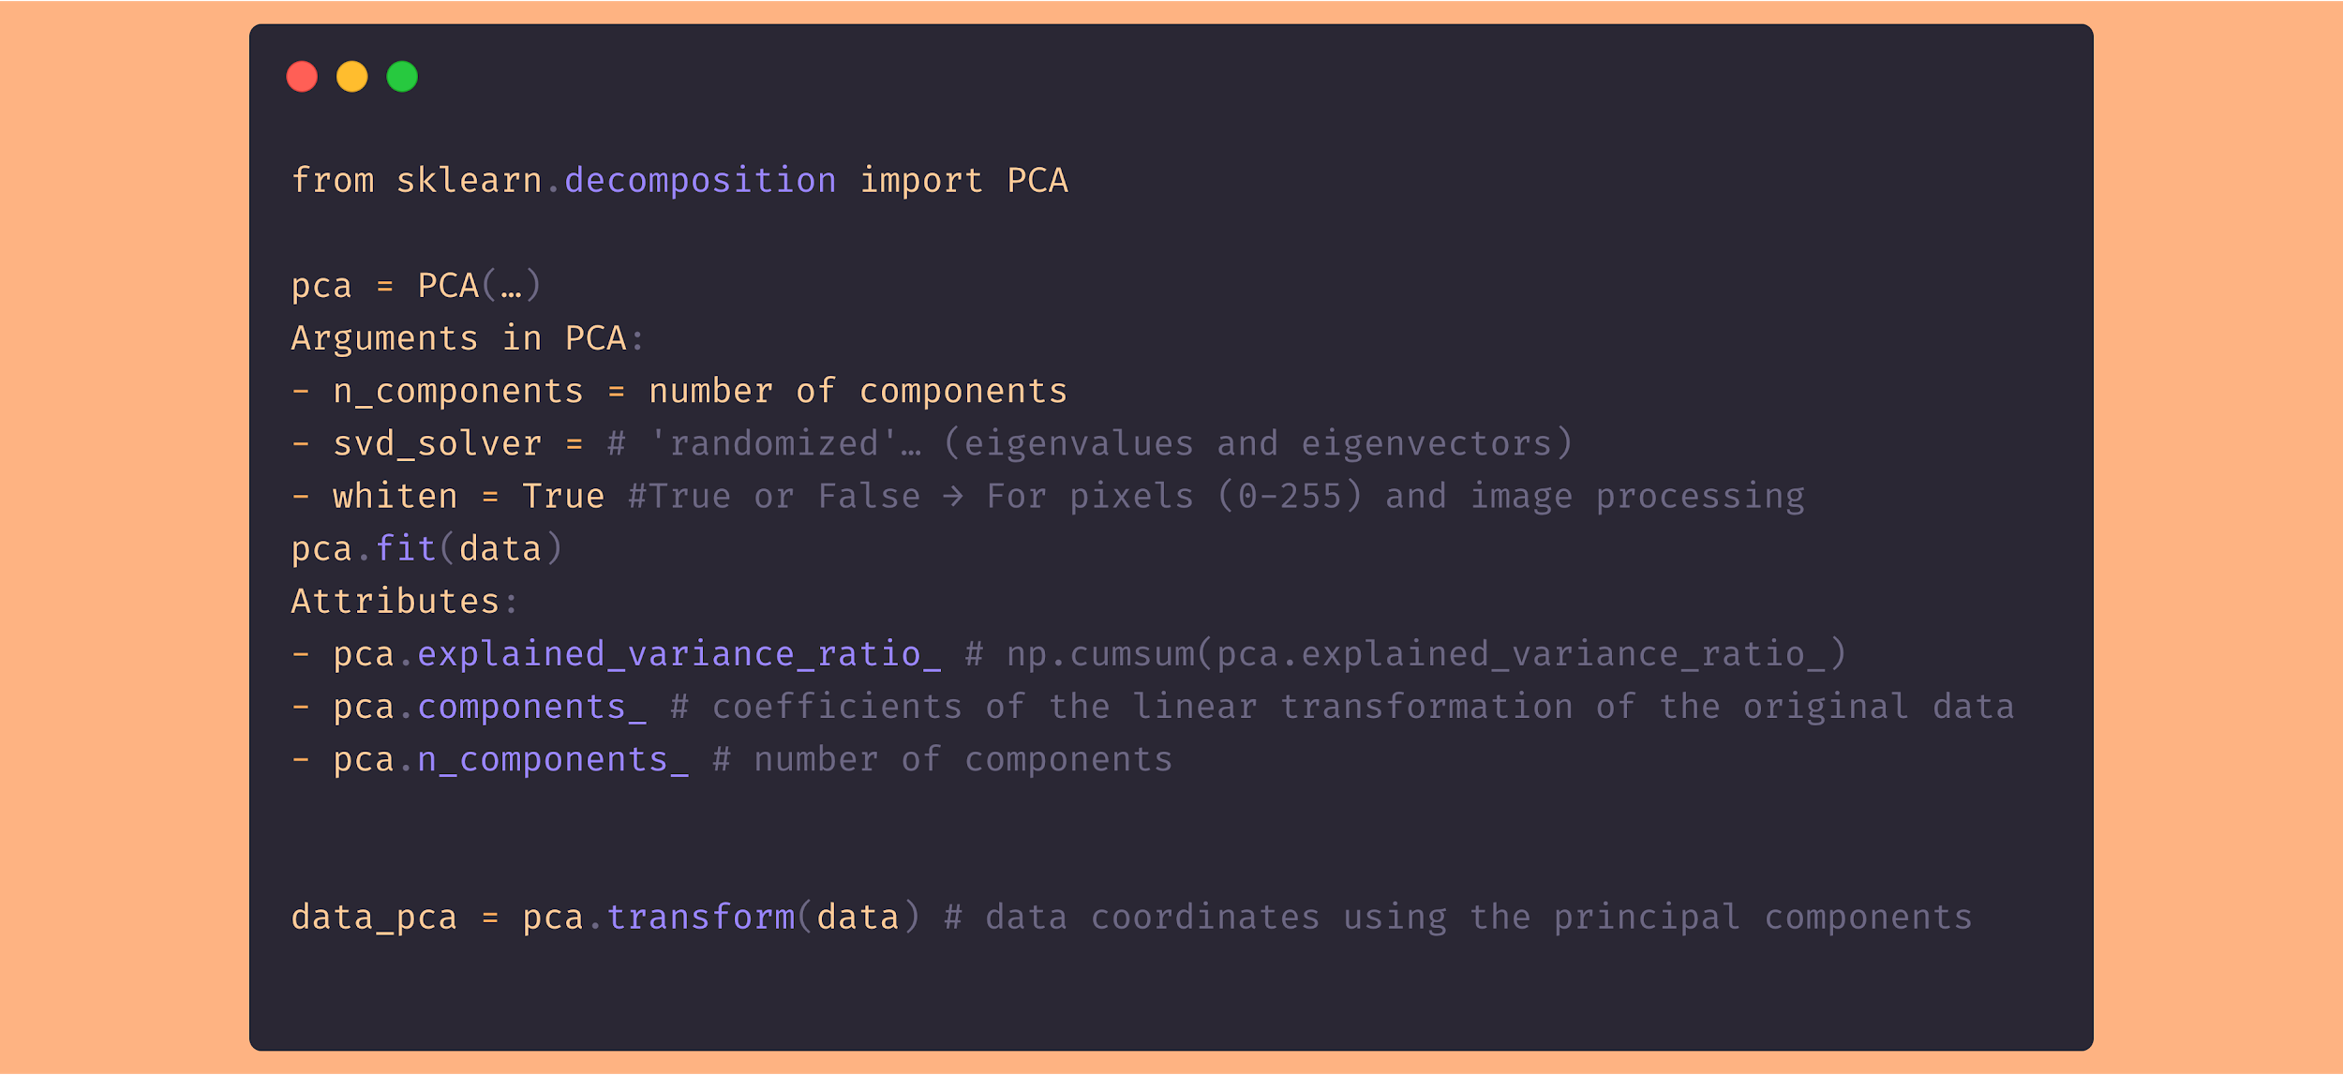
Sklearn PCA
Click on the image

Slide 21
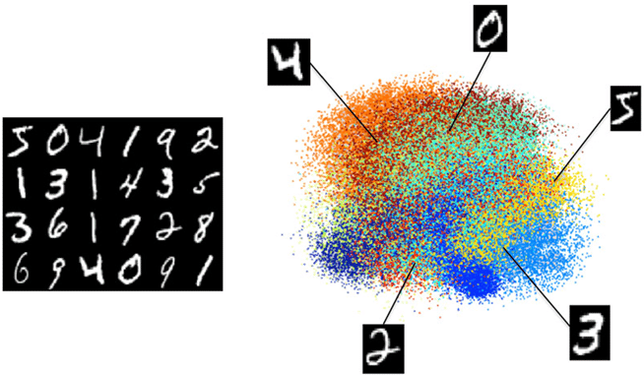
PCA Example with high dimensional data

Slide 22
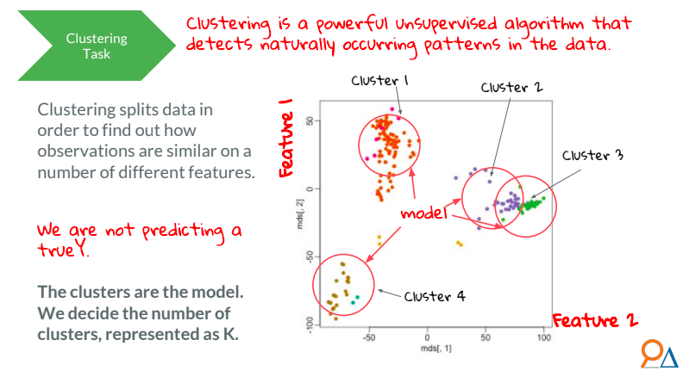
Clustering

Slide 23

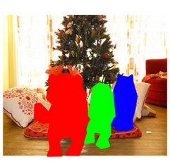

Applications of Clustering
Customer Segmentation
Document Clustering
Image Segmentation
Recommendation Engines
and more...

Slide 24
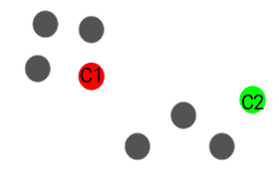
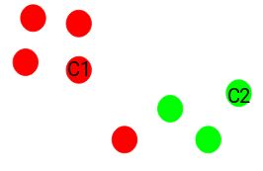
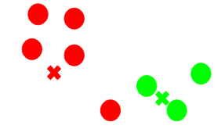
Kmeans step-by-step
Step 1: Choose the number of clusters k
Step 2: Select k random points from the data as centroids
Step 3: Assign all the points to the closest cluster centroid
Step 4: Recompute the centroids of newly formed clusters
Step 5: Repeat steps 3 and 4

Slide 25
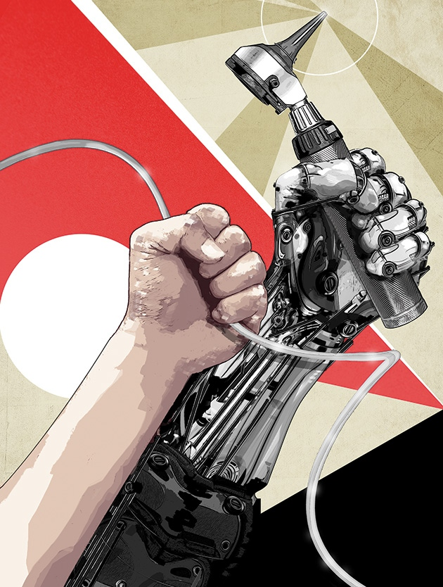
Challenge!

Slide 26
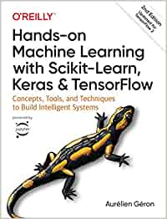
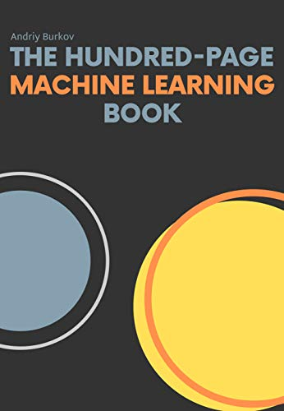

Bibliografía
/1./ /Hands-on Machine Learning with Scikit-Learn, Keras, and TensorFlow/
/2./ /Fast.AI - Introduction to Machine Learning for Coders/
/3./ /MLCourse.AI/
/4./ /DeltaAnalytics/
/5./ /The Hundred-page Machine Learning Book/
/6./ /Machine Learning for Humans (Vishal Maini)/
/7./ /Datacamp/
/8./ /DataQuest/

Slide 27

WI-FI
Wi-Fi
madrid@saturdays.ai

